Slide 1

Wordpress Migration Project

Slide 2
Our team
Tran Hoai Nam
Nguyen Minh Trang
Nguyen Mai Huong

Slide 3
Agenda
Introduction
Our project
Real project
Practice
Conclusion

Slide 4
Introduction

Slide 5
About project
Project Name: Bonnier Migration
Mentors: Mr. Ngoc Tran and Mr. Tuan Ta
Members:
Nam Tran
Trang Nguyen
Huong Nguyen

Slide 6
Project Purpose
CMS Migration
The process of moving information or data which already stored on a Web content management system (CMS) to a new system.
Notes:
Migrating from

Slide 7
Project Purpose (cont.)
Migrate content from EpiServer to Wordpress
Upgrade old Wordpress version to the latest Wordpress core version
Ensure:
The CMS platform changed
Website remains functionally, work smoothly on new platform

Slide 8
Our project

Slide 9
Real Project
Wordpress
Definition
Wordpress themes
Wordpress actions and filters
Why do we need a child theme?
What we have done
Requirements
Resolved problem

Slide 10
Wordpress

Slide 11
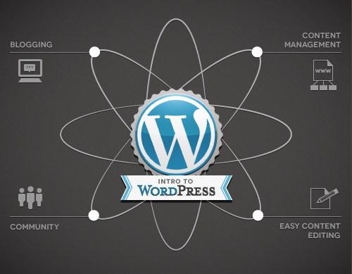
Wordpress
Notes:
Wordpress is a CMS (Content Management System)
Do the connection and interative with database. Everything is based on post type. You will interact with database by using Wordpress’s own function

Slide 12
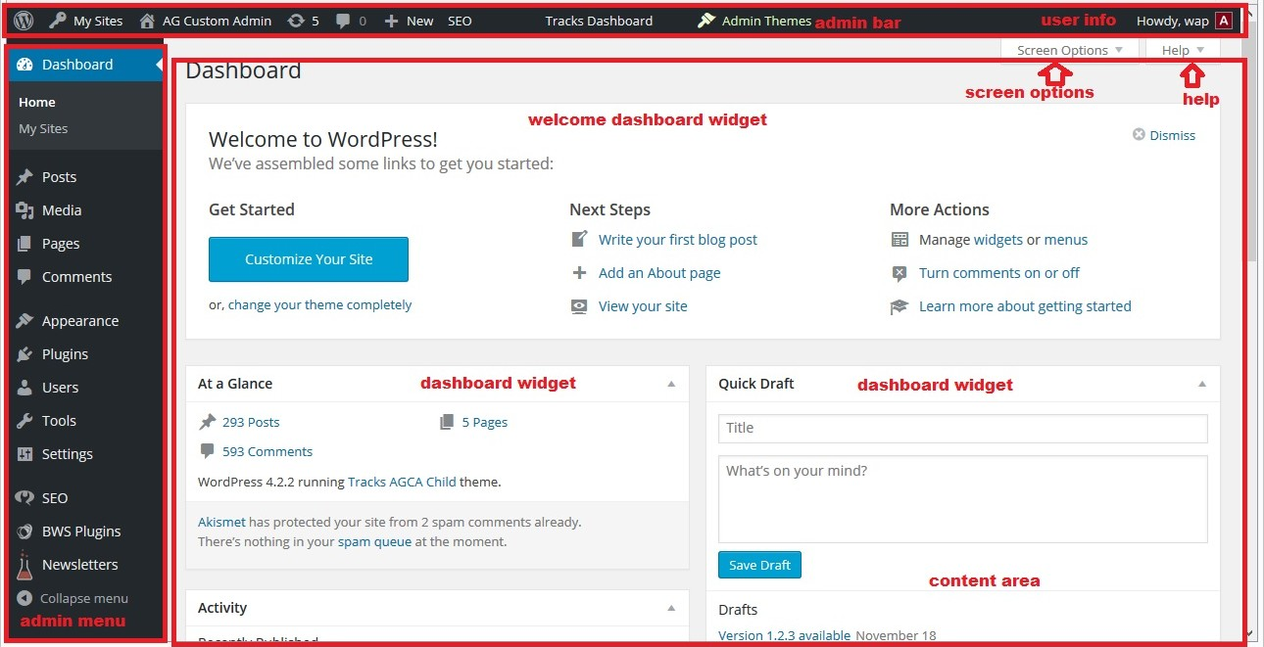

Slide 13
Wordpress theme
A WordPress theme changes the design of
your website, often including its layout
Themes take the content and data stored by
WordPress and display it in the browser

Slide 14
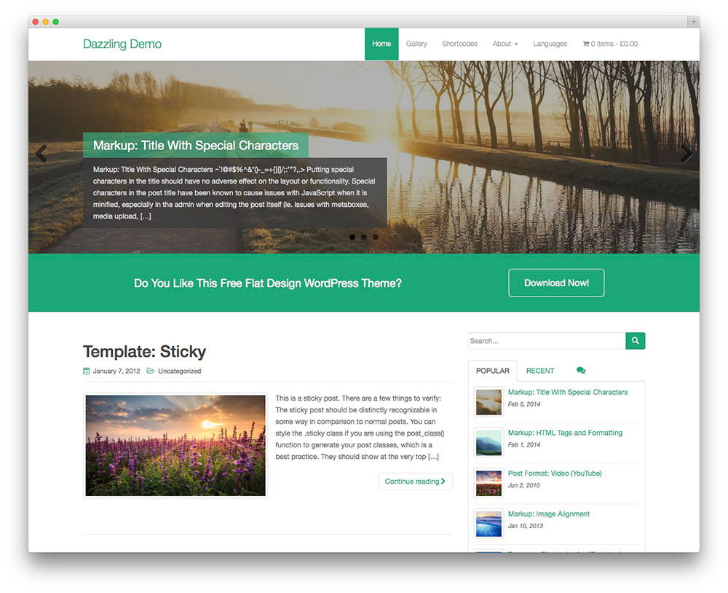

Slide 15
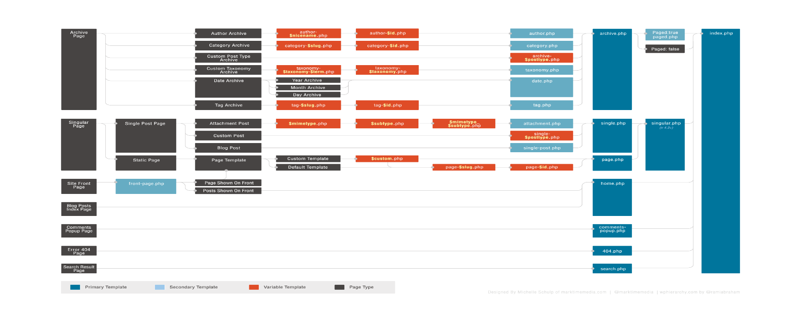
Wordpress hierarchy
Checkout here: https://wphierarchy.com/

Slide 16
Wordpress actions and filters
Wordpress hook
A “hook” is a certain location in the WordPress code which allows you to attach or run your own code
Another way of describing “hooks” is that they are sort of like designated areas within the WordPress code which give you the opportunity to execute your own functions.
Difference between actions and filters
The importance difference is filters will do something and return a value to change a default value but actions do not

Slide 17
Why we need a child theme
There are a few reasons why you would want to use a child theme:
If you modify a theme directly and it is updated, then your modifications may be lost. By using a child theme you will ensure that your modifications are preserved.
Using a child theme can speed up development time.
Using a child theme is a great way to learn about WordPress theme development.
Notes:
A child theme is a theme that inherits the functionality of another theme, called the parent theme. This then allows you to modify or add to the functionality of the parent theme in a safe manner.
The easiest explanation for why you should use a child theme is because it allows you to safely update the parent theme

Slide 18
What we have done

Slide 19
Requirements
Make a copy of damernasvarld-blog child theme and implement new theme
101 ideer’s blogs and M-magasin blogs should be based on the damernasvarld-blog child theme. The end result should be similar to the setup shown on this site: http://elin.damernasvarld.se/
Change some styles that mentioned in requirement documentation

Slide 20
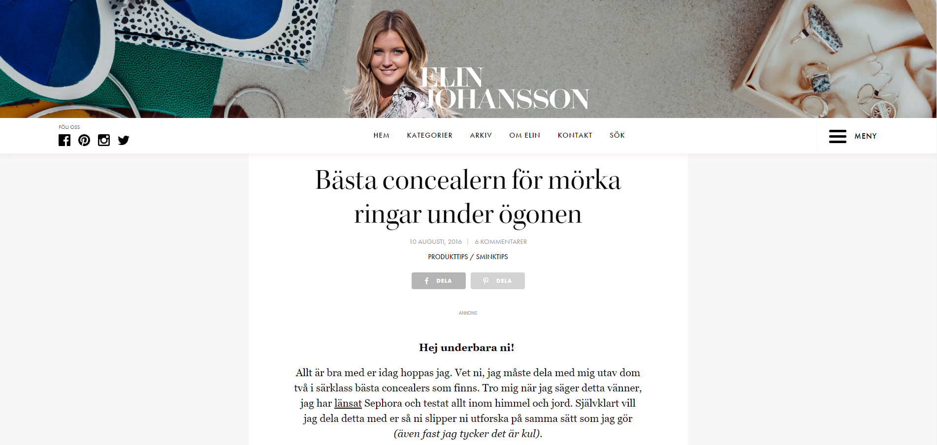

Slide 21
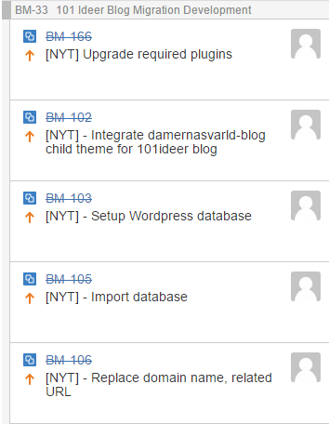
Assigned tasks
Setup Environment, database and configuration (create fake domain name in vhost file, replace that domain in database …)
Change styles based on requirements documentation and make the new theme that look similarly as the damernasvarld-blog
Verify the new theme and fix bugs
Deploy the project on local dev server and customer’s server

Slide 22
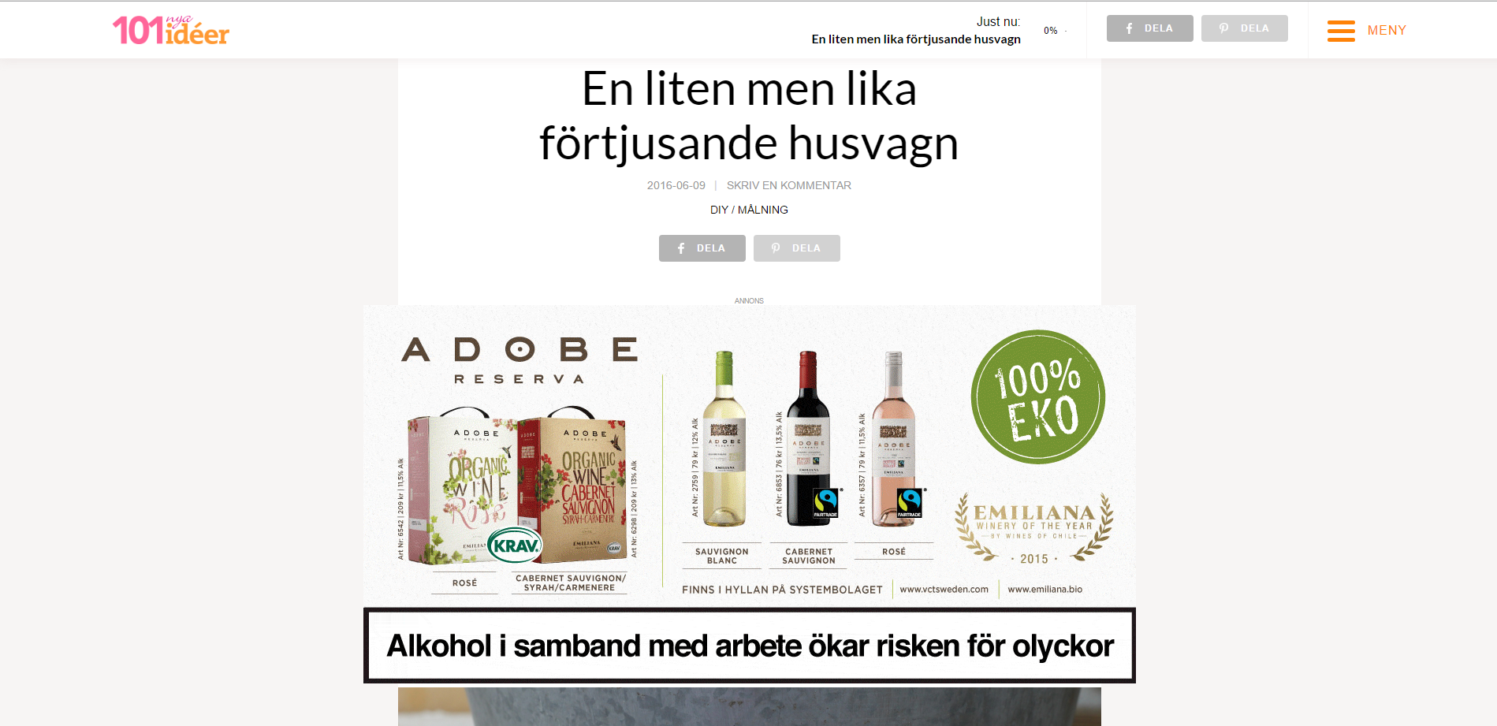
Demo websites

Slide 23
Practice: Alfuttaim – Home page
Requirements:
Build the Alfuttaim home page from its design (.psd file)
Use Handlebars, Sass and Grunt
Do it as a team

Slide 24
Practice: Alfuttaim – Home page
Solutions:
Learn Handlebars and Sass
Divide the design into sections
Work independently
Use convention to avoid conflicts
Daily meetings
VCS: Git

Slide 25
Practice: Alfuttaim – Home page
Results:
The Alfuttaim home page looks as designed
Skills:
Teamwork
Avoiding and resolving conflicts
Using new tools

Slide 26
Conclusion

Slide 27
Achievement
Basic HTML, CSS (Bootstrap), JavaScript (jQuery)
Wordpress Basic:
Theme development
Actions and filters
Grunt, Handlebars, Sass
Teamwork: Daily meeting, using Jira, Confluence, BitBucket, Git

Slide 28
Thanks for listening

Slide 29
Problem
Too large database -> take time to import
Use PHP Myadmin
Wordpress multisite

